Slide 1
CSE2016-Software Engineering Module-1

Slide 2
What is Software?
Software is: (1) instructions (computer programs) that when executed provide desired features, function, and performance; (2) data structures that enable the programs to adequately manipulate information and (3) documentation that describes the operation and use of the programs.

Slide 3
Software Applications
system software
application software
engineering/scientific software
embedded software
product-line software
WebApps (Web applications)
AI software

Slide 4
Software—New Categories
Open world computing—pervasive, distributed computing
Ubiquitous computing—wireless networks
Netsourcing—the Web as a computing engine
Open source—”free” source code open to the computing community (a blessing, but also a potential curse!)
Data mining
Grid computing
Cognitive machines
Software for nanotechnologies

Slide 5
Software Engineering
Some realities:
a concerted effort should be made to understand the problem before a software solution is developed
design becomes a pivotal activity
software should exhibit high quality
software should be maintainable
The seminal definition:
[Software engineering is] the establishment and use of sound engineering principles in order to obtain economically software that is reliable and works efficiently on real machines.

Slide 6
Software Engineering
The IEEE definition:
Software Engineering: (1) The application of a systematic, disciplined, quantifiable approach to the development, operation, and maintenance of software; that is, the application of engineering to software. (2) The study of approaches as in (1).

Slide 7
A Layered Technology
tools
methods
process model
a “quality” focus
Software Engineering

Slide 8
A Process Framework
Framework activities
work tasks
work products
milestones & deliverables
QA checkpoints
Umbrella Activities

Slide 9
Framework Activities
Communication
Planning
Modeling
Analysis of requirements
Design
Construction
Code generation
Testing
Deployment

Slide 10
Umbrella Activities
Software project management
Formal technical reviews
Software quality assurance
Software configuration management
Work product preparation and production
Reusability management
Measurement
Risk management

Slide 11
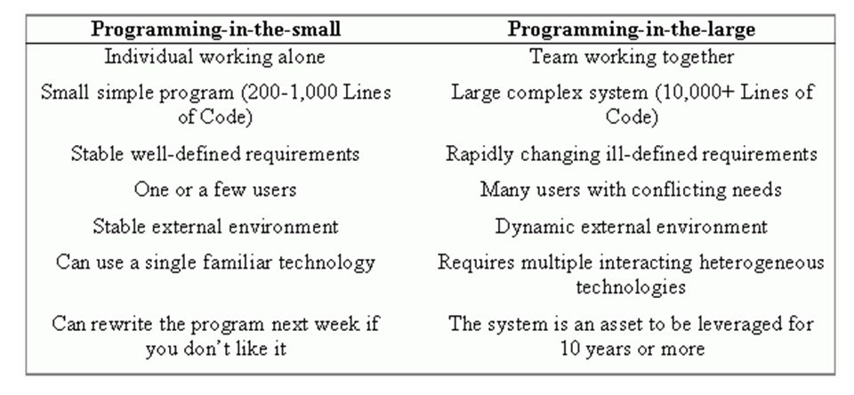
Programming in the small vs. programming in the large

Slide 12
Classification of software failures
A possible classification of failures of software products into five different types is as follows:
Transient- Transient failures occur only for certain input values while invoking a function of the system.
Permanent- Permanent failures occur for all input values while invoking a function of the system.
Recoverable- When recoverable failures occur, the system recovers with or without operator intervention.
Unrecoverable- In unrecoverable failures, the system may need to be restarted.
Cosmetic- These classes of failures cause only minor irritations, and do not lead to incorrect results. An example of a cosmetic failure is the case where the mouse button has to be clicked twice instead of once to invoke a given function through the graphical user interface

Slide 13
What is software quality?
The modern view of a quality associates with a software product several quality factors such as the following:
Portability: A software product is said to be portable, if it can be easily made to work in different operating system environments, in different machines, with other software products, etc.
Usability: A software product has good usability, if different categories of users (i.e. both expert and novice users) can easily invoke the functions of the product.
Reusability: A software product has good reusability, if different modules of the product can easily be reused to develop new products.
Correctness: A software product is correct, if different requirements as specified in the SRS document have been correctly implemented.
Maintainability: A software product is maintainable, if errors can be easily corrected as and when they show up, new functions can be easily added to the product, and the functionalities of the product can be easily modified, etc.

Slide 14
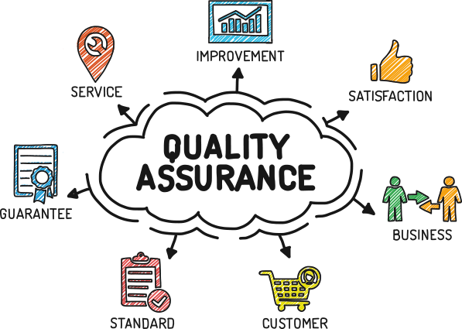

Slide 15
A quality system consists of
Managerial Structure and Individual Responsibilities- A quality system is actually the responsibility of the organization as a whole.
Quality System Activities- The quality system activities encompass the following:
auditing of projects
review of the quality system
development of standards, procedures, and guidelines, etc.
production of reports for the top management summarizing the effectiveness of the
quality system in the organization.

Slide 16
A few quality characteristics of the Quality Assurance process
Concentrate on the User Experience
Automation and Continuous Integration
Test and Code Coverage
The Shift-Left Approach
Smart Testing
Bug Prevention
Portability
Reliability
Documentation

Slide 17
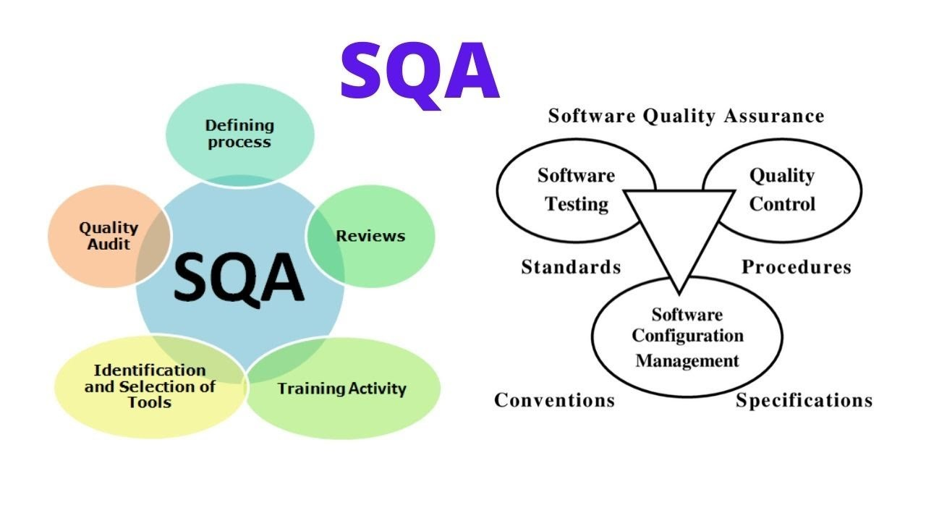

Slide 18
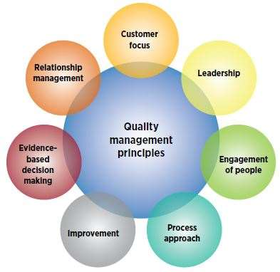
ISO 9000 Quality Management Principles

Slide 19
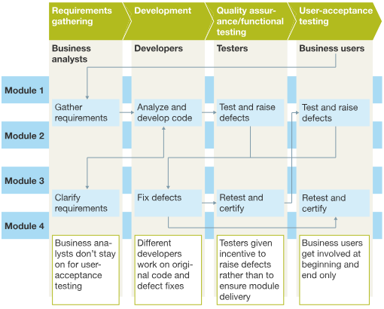
Timely availability of software engineering towards successful execution of large software projects – Traditional Approach

Slide 20
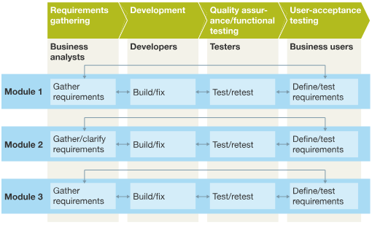
The cross-functional approach

Slide 21
Emergence of Software Engineering
Early Computer Programming
High Level Language Programming
Control Flow Based Design
Data-Flow Oriented Design
Object Oriented Design

Slide 22
Waterfall Model
The waterfall model is a sequential design process in which progress is seen as flowing steadily downwards (like a waterfall) through the phases of SDLC.
Waterfall model is an example of a Sequential model. In this model, the software development activity is divided into different phases and each phase consists of a series of tasks and has different objectives.
Waterfall model is the pioneer of the SDLC processes.
Characterized by:
Feedback loops
Documentation-driven

Slide 23
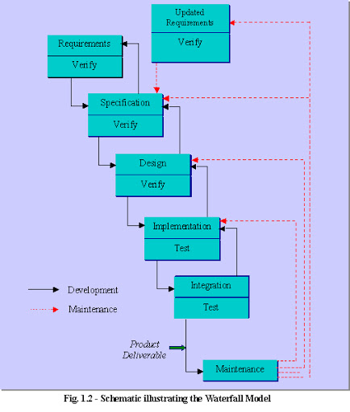

Slide 24
Waterfall Model (contd.)
Advantages
Enforces disciplined approach
Documentation for each phase
Products of each phase checked by SQA group
Maintenance is easier
Every change reflected in the relevant documentation.
Disadvantages
Working version of the software will not be available until late in the project time-span
Specifications are long, detailed, written in a style unfamiliar to the client
“Blocking states” –some project team members must wait for other team members to complete dependent tasks

Slide 25
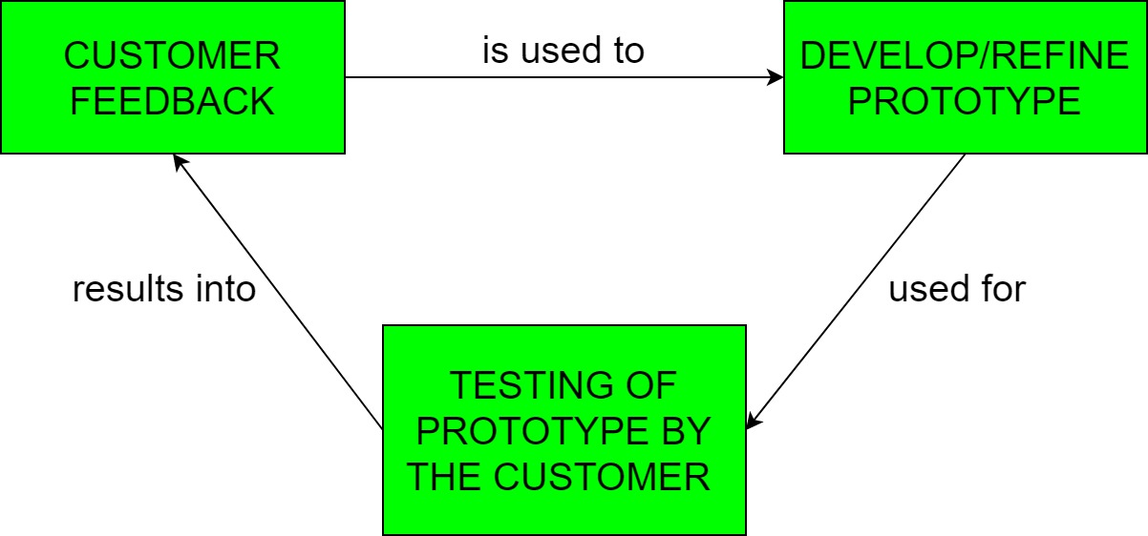
Rapid Prototyping Model
Prototyping is defined as the process of developing a working replication of a product or system that has to be engineered.
It offers a small scale replica of the end product and is used for obtaining customer feedback as described below:

Slide 26
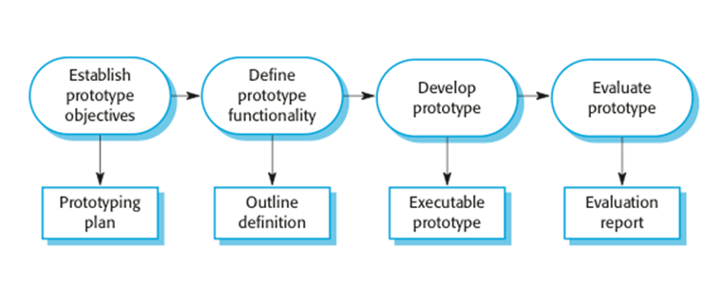
Rapid Prototyping Model (contd.)

Slide 27
Rapid Prototyping Model (contd.)
Rapid prototype characteristics:
Used in the requirements phase
Evaluated by the customer/user
Then, it is discarded -do not turn into product
Rapid prototyping model is not proven and has its own problems
Possible solution
Rapid prototyping for defining requirements
Waterfall model for rest of life cycle

Slide 28
Incremental Model
Incremental Model is a process of software development where requirements are broken down into multiple standalone modules of software development cycle.
Each iteration passes through the requirements, design, coding and testing phases.
Typical product takes from 5 to 25 builds (iterations).

Slide 29
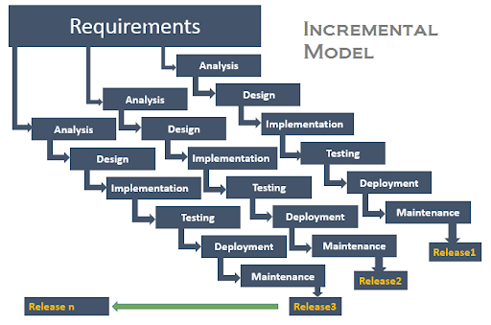
Incremental Model (contd.)

Slide 30
Incremental Model (contd.)
Waterfall and rapid prototyping models
Deliver complete product at the end
Incremental model
Deliver portion of the product at each stage
Advantages
The software will be generated quickly during the software life cycle
It is flexible and less expensive to change requirements and scope
Throughout the development stages changes can be done
This model is less costly compared to others
A customer can respond to each building
Errors are easy to be identified

Slide 31
Incremental Model (contd.)
Disadvantages:
It requires a good planning designing
Problems might arise due to system architecture as not all requirements collected up front for the entire software lifecycle
Each iteration phase is rigid and does not overlap each other
Correcting a problem in one unit requires correction in all the units and consumes a lot of time

Slide 32
When to use Incremental models?
Requirements of the system are clearly understood
When demand for an early release of a product arises
When software engineering team are not very well skilled or trained
When high-risk features and goals are involved
Such methodology is more in use for web application and product based companies

Slide 33
Spiral Model
The spiral model is a risk-driven software development process model.
Based on the unique risk patterns of a given project, the spiral model guides a team to adopt elements of one or more process models, such as incremental, waterfall, or evolutionary prototyping.
Risk Analysis: Identification of potential risk is done while risk mitigation strategy is planned and finalized
Precede each phase by
Alternatives
Risk analysis
Follow each phase by
Evaluation
Planning of next phase
Notes:
Examples of Software Risks include:
1- Estimation and scheduling
2- Sudden growth in requirements
3- Employee turnover
4- Productivity issues
5- Compromising on designs
6- Technical risks

Slide 34
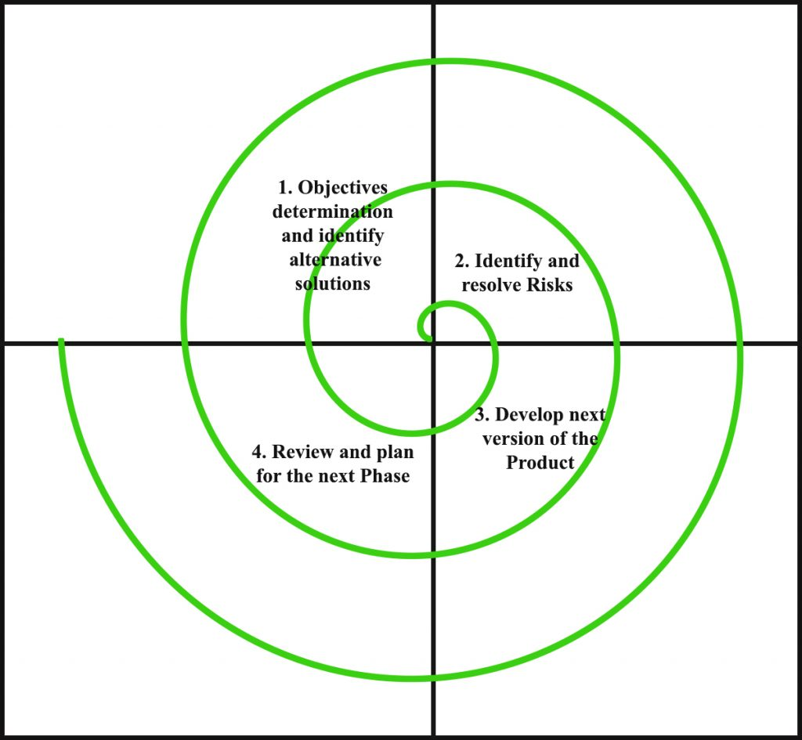
Simplified Spiral Model

Slide 35
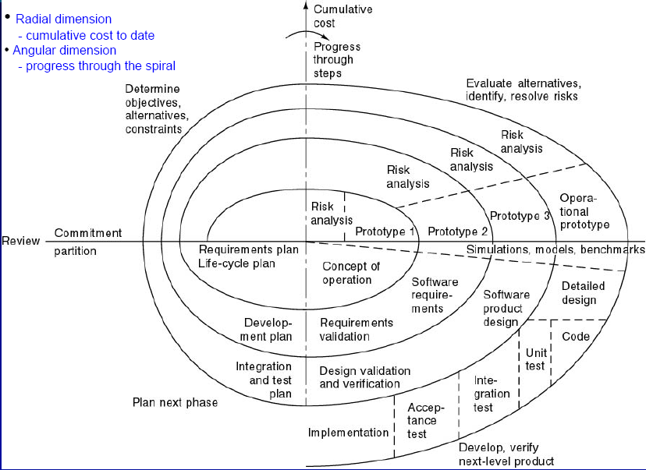
Full Spiral Model

Slide 36
When to use Spiral Methodology?
When project is large
When releases are required to be frequent
When creation of a prototype is applicable
When risk and costs evaluation is important
For medium to high-risk projects
When requirements are unclear and complex
When changes may require at any time
When long term project commitment is not feasible due to changes in economic priorities

Slide 37
Advantages of Spiral Model
Additional functionality or changes can be done at a later stage
Cost estimation becomes easy as the prototype building is done in small fragments
Continuous or repeated development helps in risk management
Development is fast and features are added in a systematic way
There is always a space for customer feedback

Slide 38
Disadvantages of Spiral Model
Risk of not meeting the schedule or budget
It works best for large projects only also demands risk assessment expertise
For its smooth operation spiral model protocol needs to be followed strictly
Documentation is more as it has intermediate phases
It is not advisable for smaller project, it might cost them a lot

Slide 39
Agile Process Models
Agile software engineering combines a philosophy and a set of development guidelines
Philosophy
Encourages customer satisfaction and early incremental delivery of the software
Small highly motivated project teams
Informal methods
Minimal software engineering work products
Overall development simplicity
Development guidelines
Stress delivery over analysis and design
Active and continuous communication between developers and customers

Slide 40
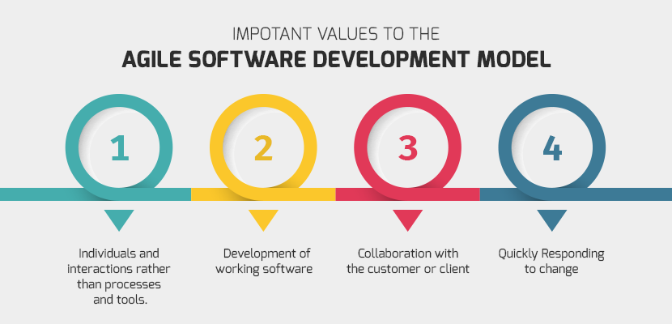
Agile Process Models (contd.)

Slide 41
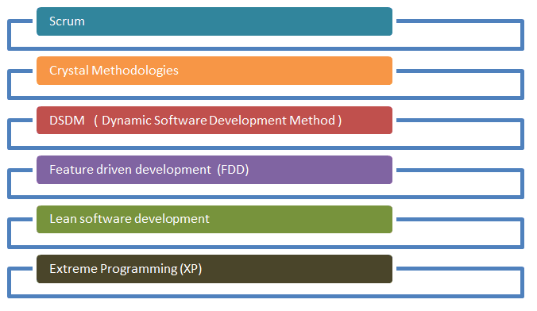
Agile Process Models (contd.)
Notes:
Presentation Required!

Slide 42
Agile vs. Waterfall Method
Agile Model | Waterfall Model
Agile method proposes incremental and iterative approach to software design | Development of the software flows sequentially from start point to end point.
The agile process is broken into individual models that designers work on | The design process is not broken into an individual models
The customer has early and frequent opportunities to look at the product and make decision and changes to the project | The customer can only see the product at the end of the project
Agile model is considered unstructured compared to the waterfall model | Waterfall model are more secure because they are so plan oriented

Slide 43
Agile vs. Waterfall Method (contd.)
Agile Model | Waterfall Model
Small projects can be implemented very quickly. For large projects, it is difficult to estimate the development time. | All sorts of project can be estimated and completed.
Error can be fixed in the middle of the project. | Only at the end, the whole product is tested. If the requirement error is found or any changes have to be made, the project has to start from the beginning.
Development process is iterative, and the project is executed in short (2-4) weeks iterations. Planning is very less. | The development process is phased, and the phase is much bigger than iteration. Every phase ends with the detailed description of the next phase.
Documentation attends less priority than software development | Documentation is a top priority and can even use for training staff and upgrade the software with another team

Slide 44
Agile vs. Waterfall Method (contd.)
Agile Model | Waterfall Model
In agile testing when an iteration end, shippable features of the product is delivered to the customer. New features are usable right after shipment. It is useful when you have good contact with customers. | All features developed are delivered at once after the long implementation phase.
Testers and developers work together | Testers work separately from developers
At the end of every sprint, user acceptance is performed | User acceptance is performed at the end of the project.
It requires close communication with developers and together analyze requirements and planning | Developer does not involve in requirement and planning process. Usually, time delays between tests and coding

Slide 45
Advantages of Agile Model
Customer satisfaction by rapid, continuous delivery of useful software.
People and interactions are emphasized rather than process and tools. Customers, developers and testers constantly interact with each other.
Working software is delivered frequently (weeks rather than months).
Face-to-face conversation is the best form of communication.
Close, daily cooperation between business people and developers.
Regular adaptation to changing circumstances.
Even late changes in requirements are welcomed

Slide 46
Disadvantages of Agile model
In case of some software deliverables, especially the large ones, it is difficult to assess the effort required at the beginning of the software development life cycle.
There is lack of emphasis on necessary designing and documentation.
The project can easily get taken off track if the customer representative is not clear what final outcome that they want.
Only senior programmers are capable of taking the kind of decisions required during the development process. Hence it has no place for newbie programmers, unless combined with experienced resources.

Slide 47
When to use Agile model
When new changes need to be implemented. The freedom agile gives to change is very important. New changes can be implemented at very little cost because of the frequency of new increments that are produced.
To implement a new feature the developers need to lose only the work of a few days, or even only hours, to roll back and implement it.
Both system developers and stakeholders alike, find they also get more freedom of time and options than if the software was developed in a more rigid sequential way.
Having options gives them the ability to leave important decisions until more or better data or even entire hosting programs are available; meaning the project can continue to move forward without fear of reaching a sudden standstill.

Slide 48
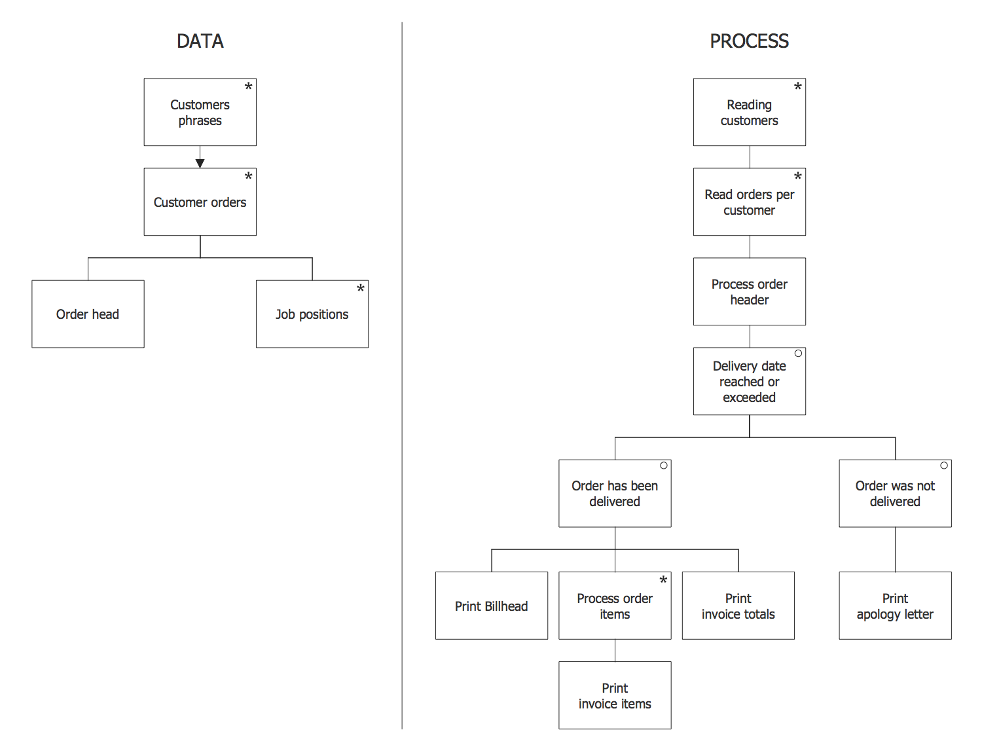
Jackson Structured Programming (Example)

